Slide 1

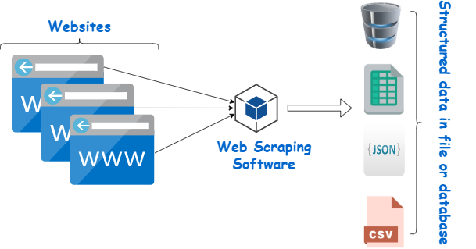
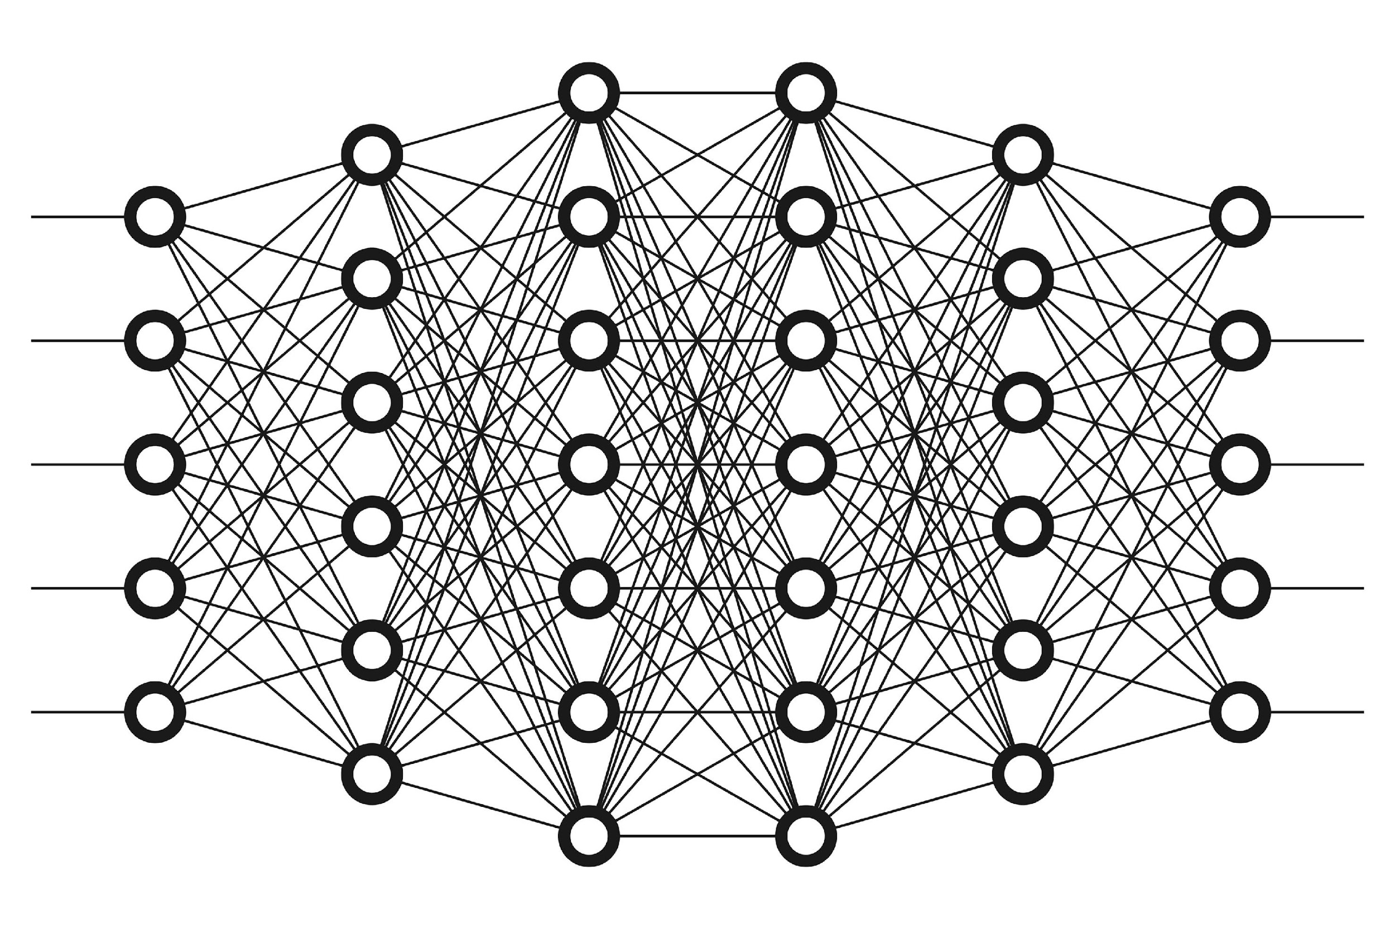
IMAGE SCRAPING AND CLASSIFICATION
- TWINKLE PATEL

Slide 2
INTRODUCTION
Classification is a systematic arrangement in groups and categories based on its features. Image classification came into existence for decreasing the gap between the computer vision and human vision by training the computer with the data. The image classification is achieved by differentiating the image into the prescribed category based on the content of the vision. We use Deep Learning to accomplish the task of image Classification.
In this project we have to classify whether is image is of a jeans , a trouser or a saree. We could we such model either for automatic segmentation of items using IOT and techniques for Industry 4.0

Slide 3
CONCEPTUAL BACKGROUND OF THE DOMAIN PROBLEM
Deep learning (DL) is a sub field to the machine learning, capable of learning through its own method of computing. A deep learning model is introduced to persistently break down information with a homogeneous structure like how a human would make determinations. To accomplish this, deep learning utilizes a layered structure of several algorithms expressed as an artificial neural system (ANN). The architecture of an ANN is simulated with the help of the biological neural network of the human brain. This makes the deep learning most capable than the standard machine learning models.
In deep neural networks every node decides its basic inputs by itself and sends it to the next tier on behalf of the previous tier. We train the data in the networks by giving an input image and conveying the network about its output. Neural networks are expressed in
terms of number of layers involved for producing the inputs and outputs and the depth of the neural network.

Slide 4
ANALYTICAL PROBLEM FRAMING
We have scraped images of all 3 classes that is men jeans, men trouser and saree from the internet and we have built our model by training it on this data.
We have used transfer learning to get state of the art results for our model.
Data has been scraped from amazon.com using a python script which with selenium. All the data is in the .jpg image format.
We have over 250 images per class.

Slide 5
MODEL SUMMARY
_________________________________________________________________
block3_conv3 (Conv2D) (None, 64, 64, 256) 590080
_________________________________________________________________
block3_pool (MaxPooling2D) (None, 32, 32, 256) 0
_________________________________________________________________
block4_conv1 (Conv2D) (None, 32, 32, 512) 1180160
_________________________________________________________________
block4_conv2 (Conv2D) (None, 32, 32, 512) 2359808
_________________________________________________________________
block4_conv3 (Conv2D) (None, 32, 32, 512) 2359808
_________________________________________________________________
block4_pool (MaxPooling2D) (None, 16, 16, 512) 0
_________________________________________________________________
block5_conv1 (Conv2D) (None, 16, 16, 512) 2359808
_________________________________________________________________
block5_conv2 (Conv2D) (None, 16, 16, 512) 2359808
_________________________________________________________________
block5_conv3 (Conv2D) (None, 16, 16, 512) 2359808
_________________________________________________________________
block5_pool (MaxPooling2D) (None, 8, 8, 512) 0
_________________________________________________________________
flatten_4 (Flatten) (None, 32768) 0
_________________________________________________________________
dense_4 (Dense) (None, 3) 98307
=================================================================
Total params: 14,812,995
Trainable params: 98,307
Non-trainable params: 14,714,688
Model: "model_4"
_________________________________________________________________
Layer (type) Output Shape Param #
=================================================================
input_5 (InputLayer) [(None, 256, 256, 3)] 0
_________________________________________________________________
block1_conv1 (Conv2D) (None, 256, 256, 64) 1792
_________________________________________________________________
block1_conv2 (Conv2D) (None, 256, 256, 64) 36928
_________________________________________________________________
block1_pool (MaxPooling2D) (None, 128, 128, 64) 0
_________________________________________________________________
block2_conv1 (Conv2D) (None, 128, 128, 128) 73856
_________________________________________________________________
block2_conv2 (Conv2D) (None, 128, 128, 128) 147584
_________________________________________________________________
block2_pool (MaxPooling2D) (None, 64, 64, 128) 0
_________________________________________________________________
block3_conv1 (Conv2D) (None, 64, 64, 256) 295168
_________________________________________________________________
block3_conv2 (Conv2D) (None, 64, 64, 256) 590080
_________________________________________________________________

Slide 6
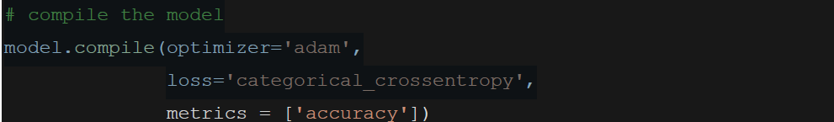
COMPILE DETAILS

Slide 7
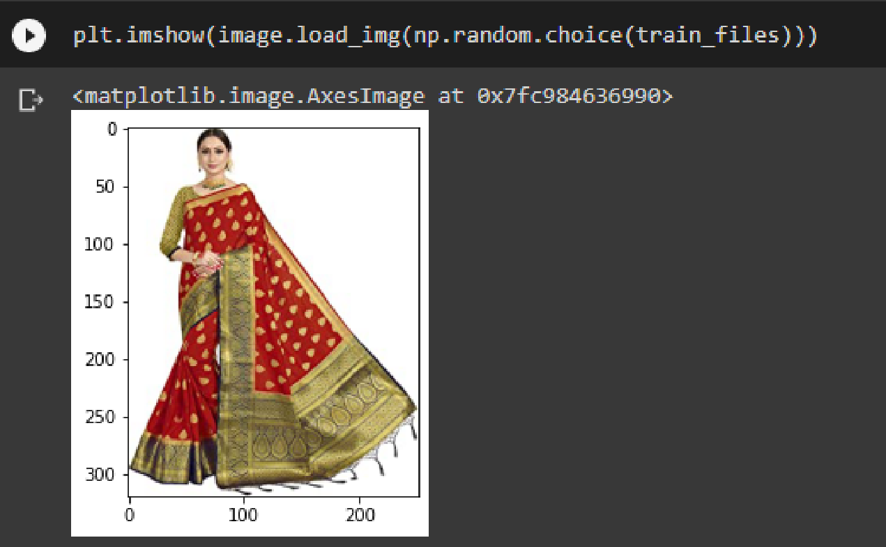
RAW DATA TESTING
A Random image from
the training set:

Slide 8
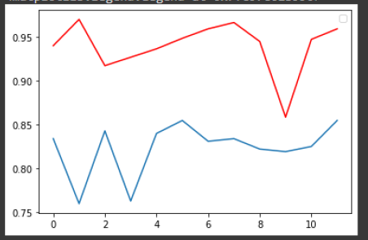
MODEL EVALUATION
Model Accuracy
RED: Train Set
BLUE: Test Set

Slide 9
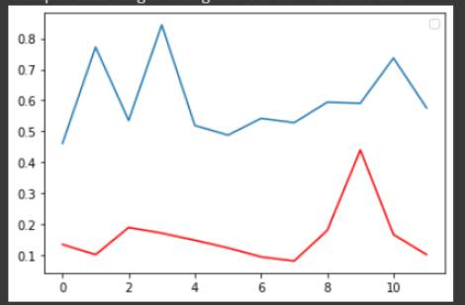
MODEL EVALUATION
Model Loss
RED: Train Set
BLUE: Test Set

Slide 10
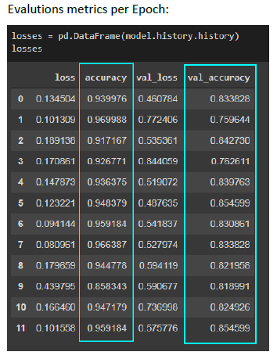
MODEL EVLATION METRICS PER EPOCH

Slide 11
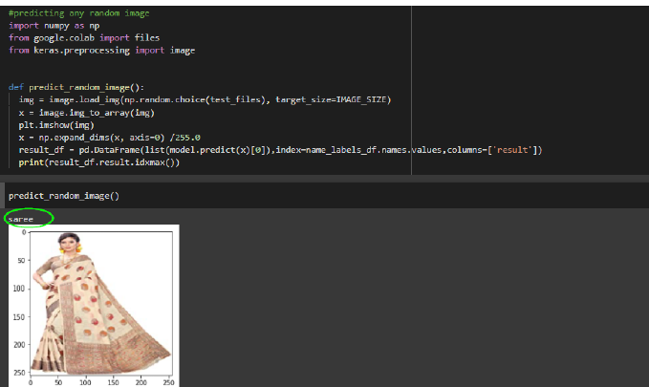
RESULT INTERPERATION

Slide 12
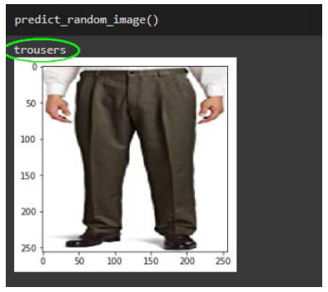
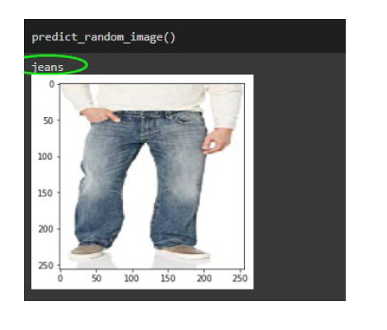
RESULT INTERPERATION

Slide 13
KEY FINDINGS
Our model was successfully to classify the images with an accuracy of 85 Percent on a validation set of around 70 images
The larger the data the better the model could predict.
Multi class prediction are somewhat relatively harder to train in comparison to a Binary class prediction.
Data Augmentation is necessary where we have small datasets of images.
One could always provide more data for training the model in order to get better results.

Slide 14
SIGNING OFF…
THANK YOU FOR YOUR TIME AND ATTENTION

